Slide 1
QUESTION PAPER MANAGEMENT

Slide 2
TEAM-3
Shiva Teja goud - API
Harish Akula - API
V.Rahul - WEB APP
Manideep kumar - WEB APP
Aishwarya Jaini - WEB APP
Sai Pothuri - ANDROID
Juwairiyyah - ANDROID
Mamidala Kruthika - ANDROID

Slide 3
Problem Statement
All Question Papers Management:
USERS:
-Login,view previous question papers sorted them sem wise branch wise etc.
-Gets upload notification(can upload a picture)
ADMIN:
-Login
-Upload exam timetable/edit
-According to timetable,after the exam ends,user gets notified to upload question paper(automatic)
-Views all the requests for particular exam,branch,year verifies and clicks upload
-When uploaded,the exam slot should disable upload option and display question paper
-Change uploaded picture

Slide 4
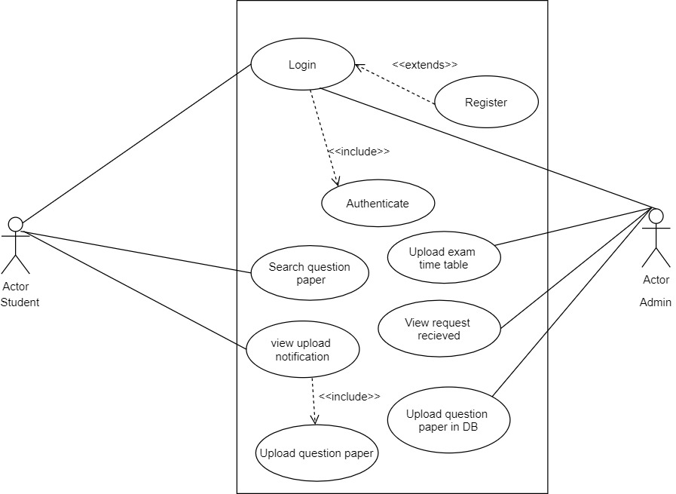
UML DIAGRAM

Slide 5
OVERVIEW OF ADMIN:
Login
Home that directs you to :
Upload paper
Upload TimeTable
Change TimeTable
Check user upload

Slide 6
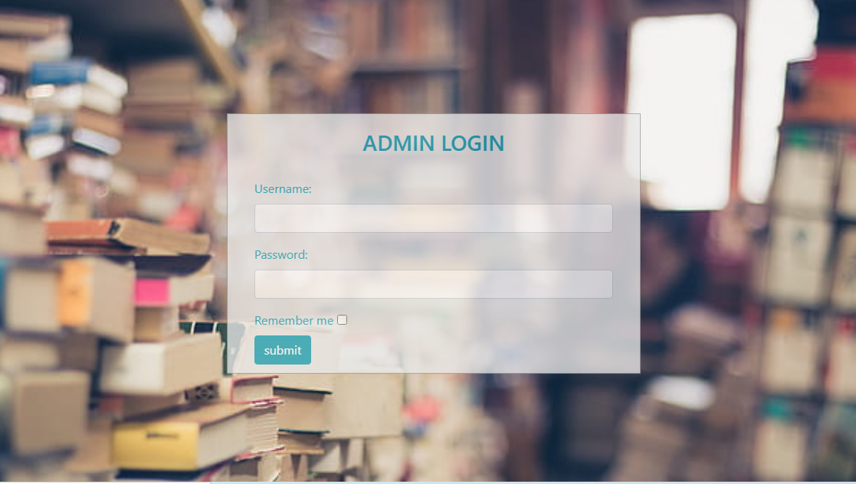
Admin UI

Slide 7
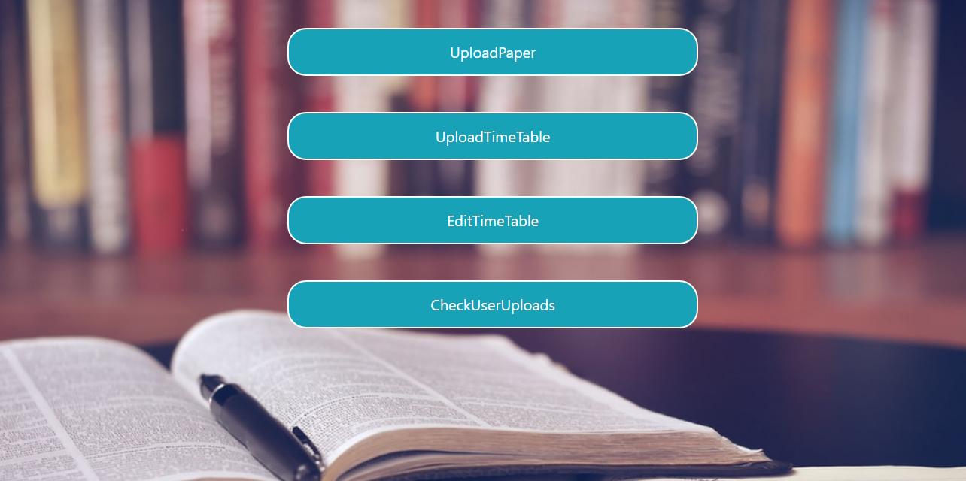
HOME PAGE FOR ADMIN

Slide 8
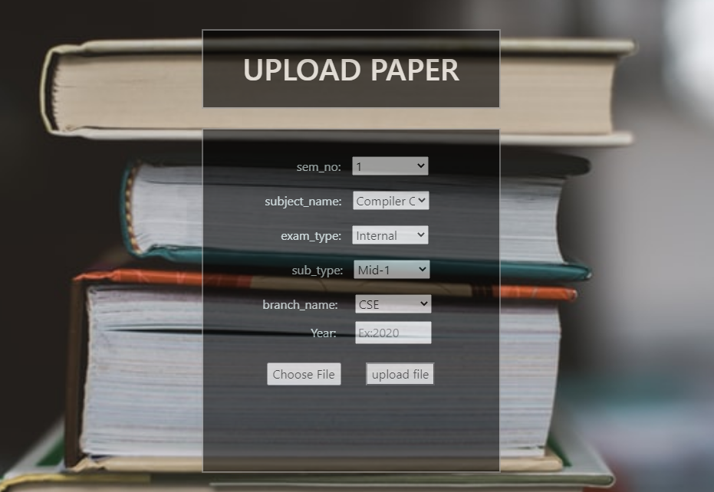

Slide 9
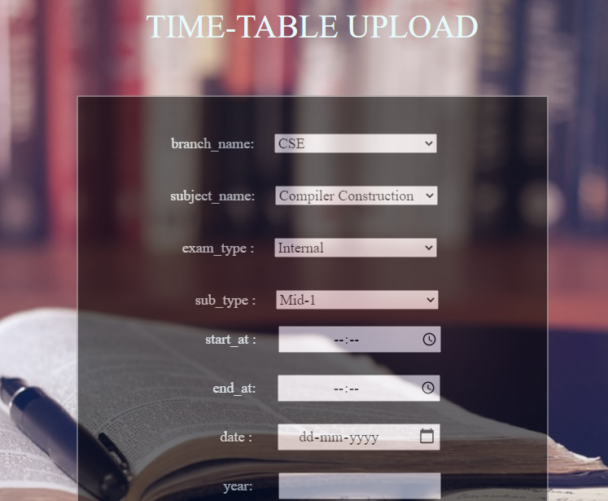

Slide 10
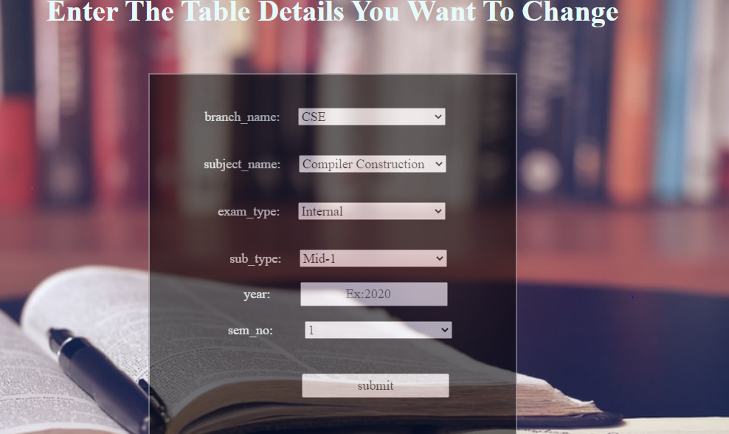
.

Slide 11
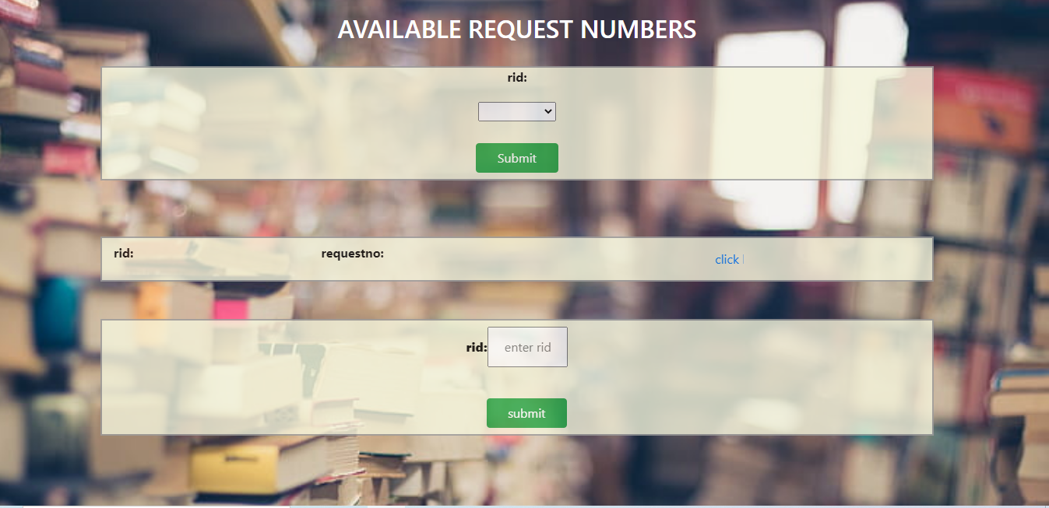
Here the admin gets to choose the request numbers and select the image admin wants

Slide 12
Activity 1: registration and login
Activity 2: upload picture of paper
Activity 3: Searching the question papers
Overview of Mobile App:

Slide 13
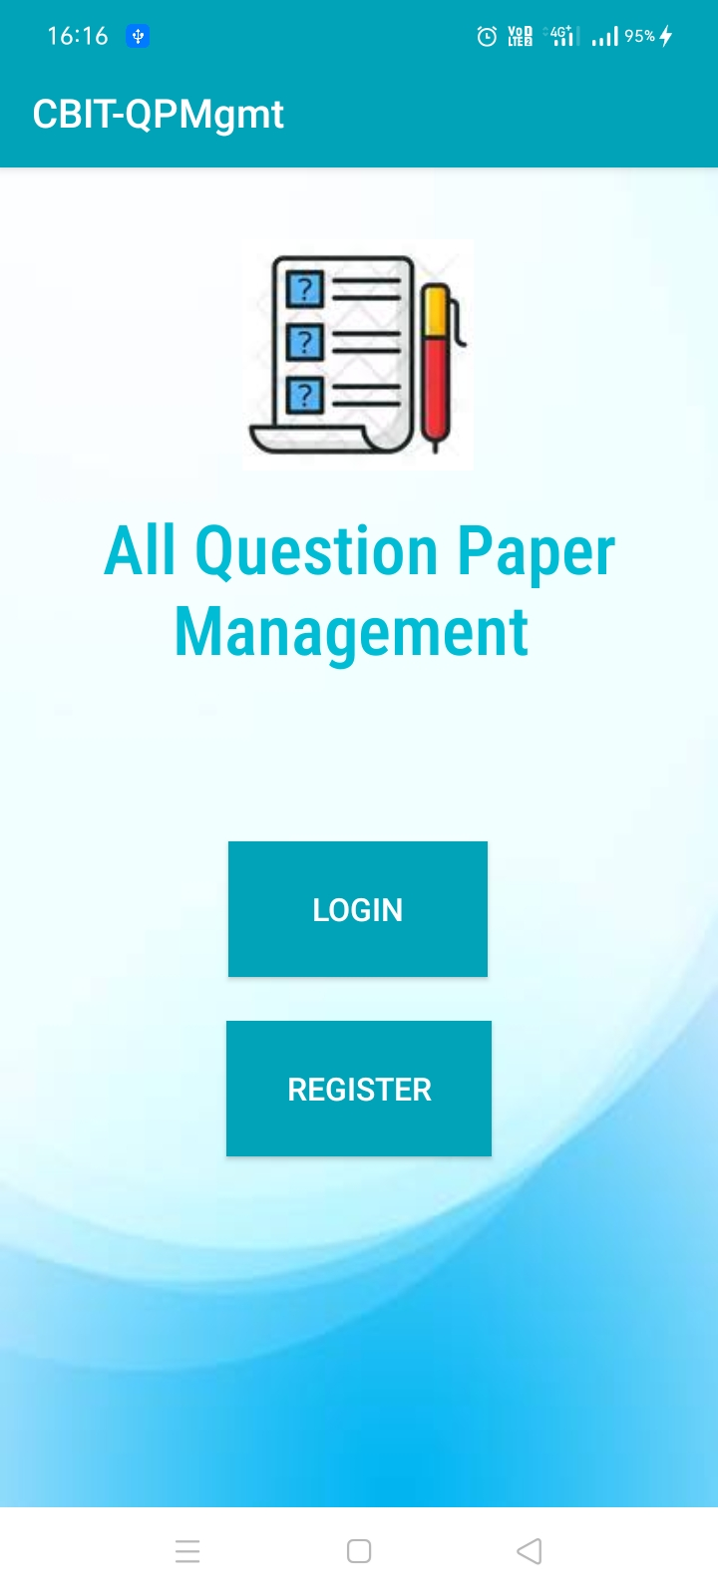
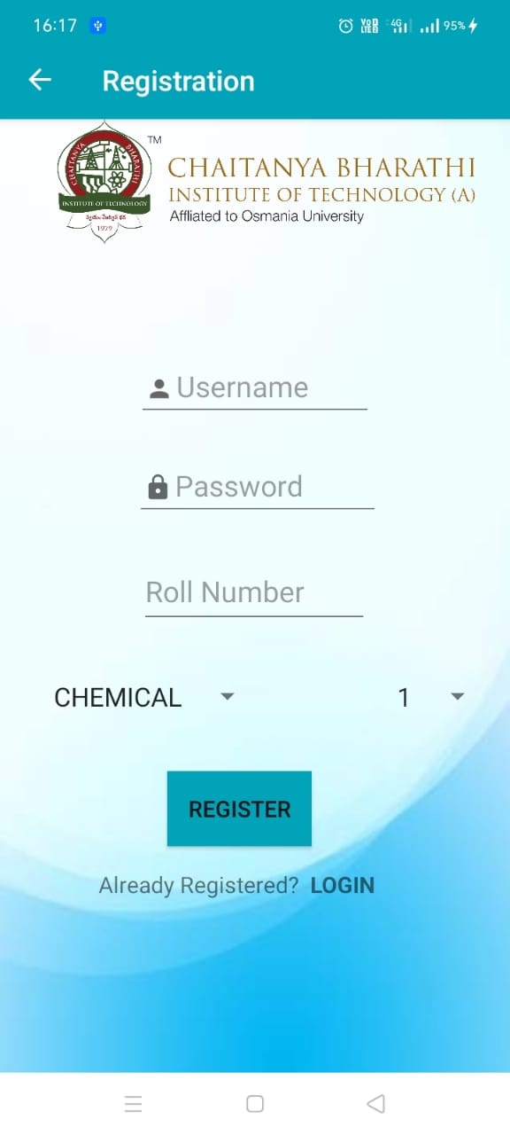
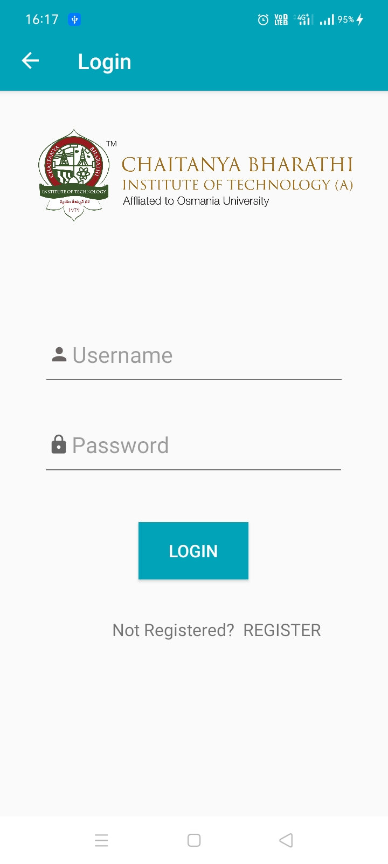
REGISTRATION AND LOGIN FOR USERS

Slide 14
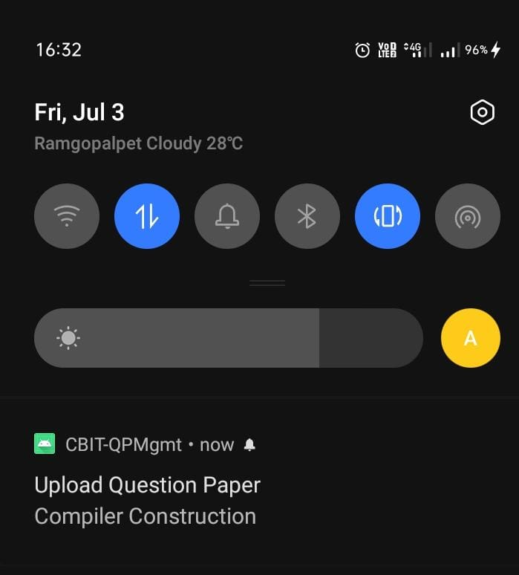
This is the notification sent to the user to upload question paper.

Slide 15
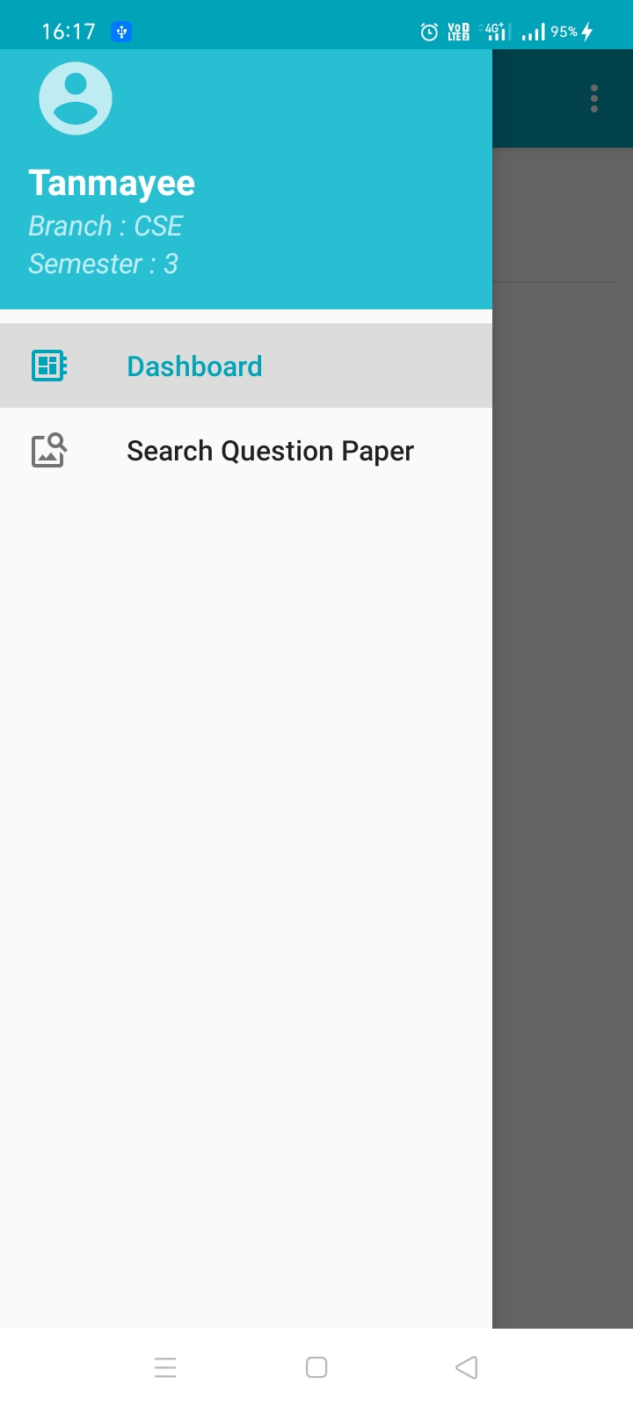
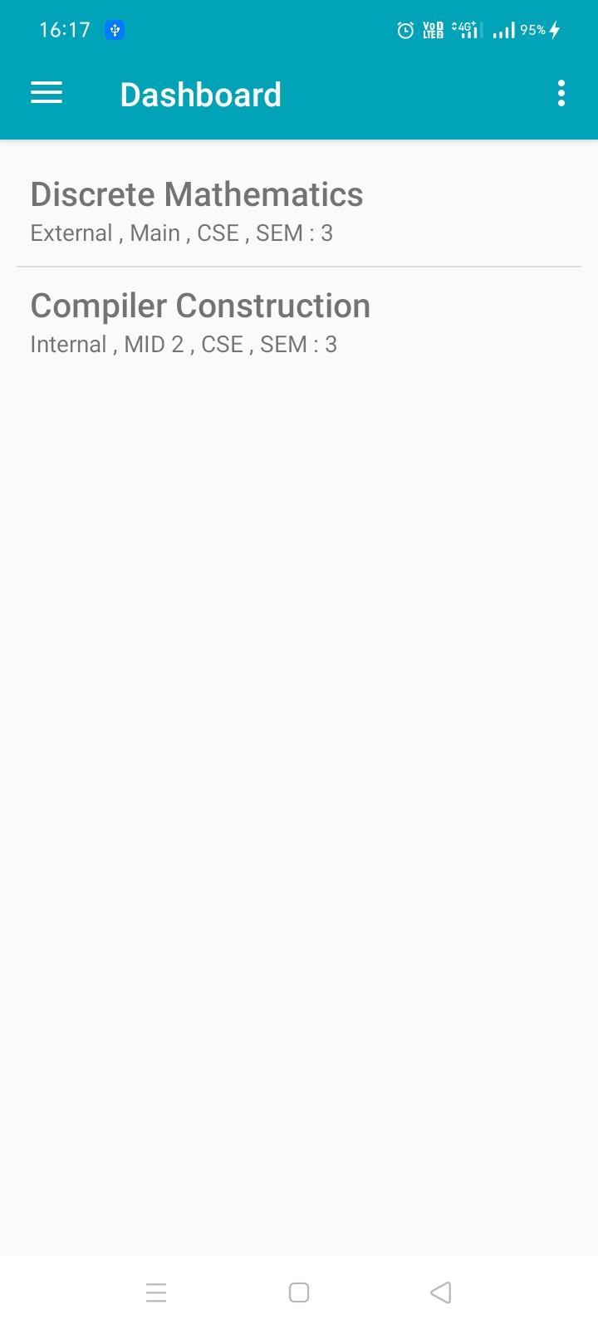
On clicking the dashboard button….

Slide 16
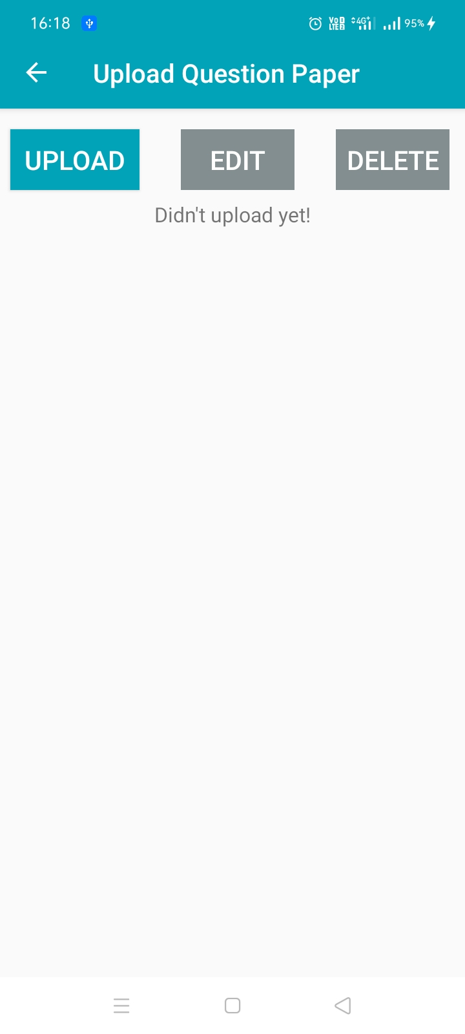
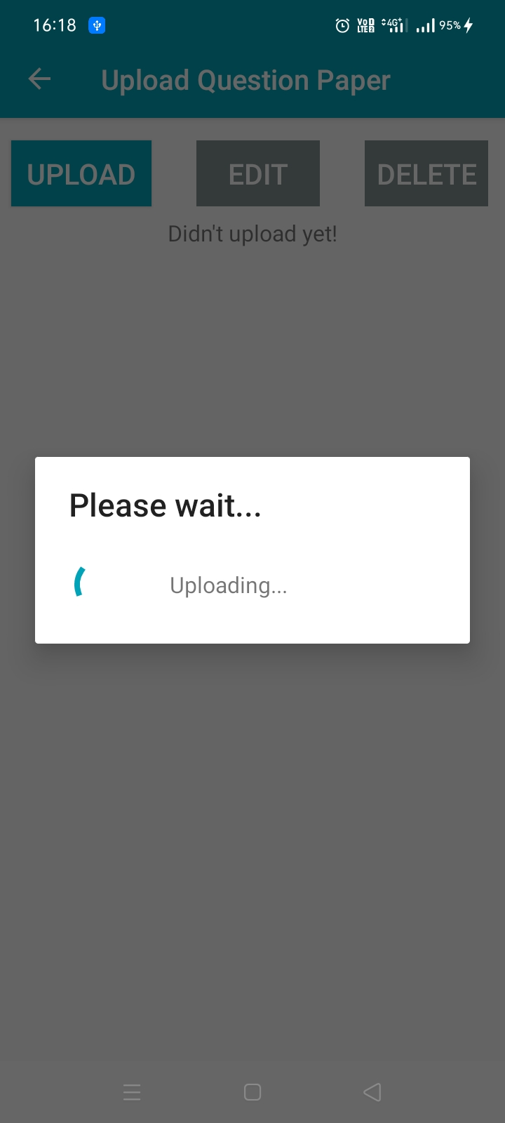
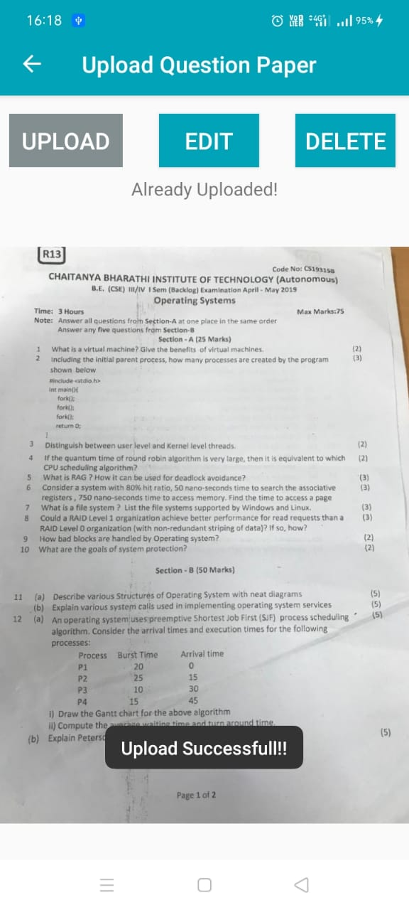
On clicking the subject name the user gets the option ‘upload’.

Slide 17
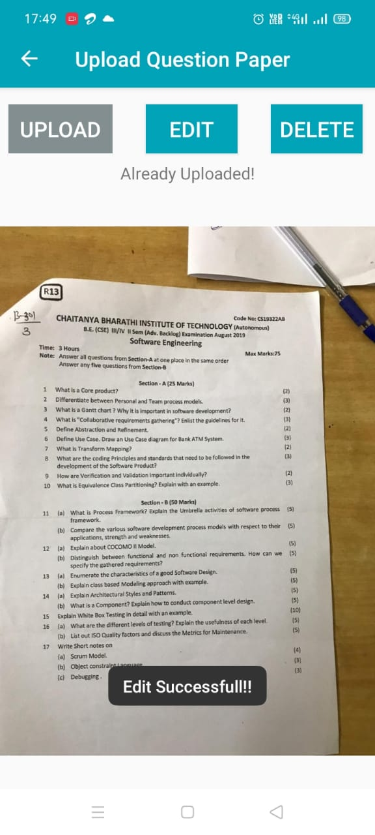
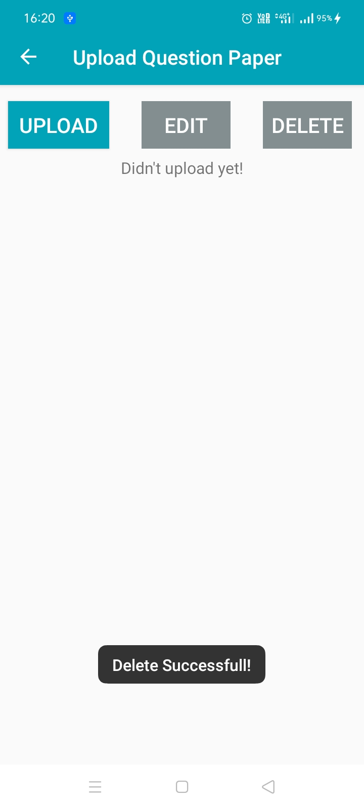
User can also edit or delete the picture.

Slide 18
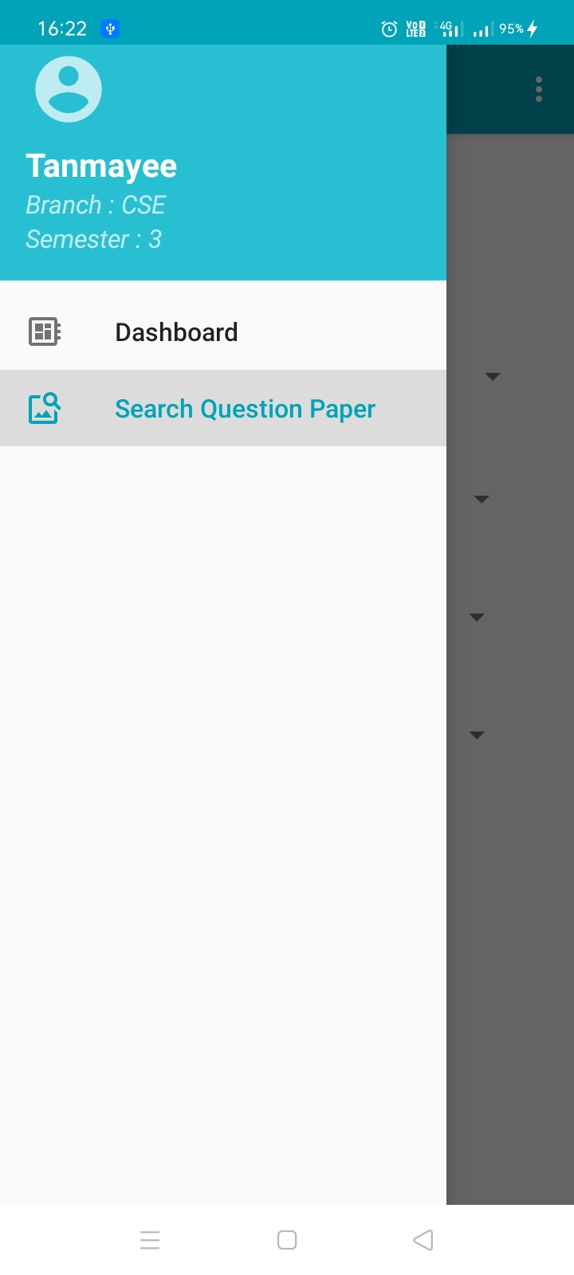
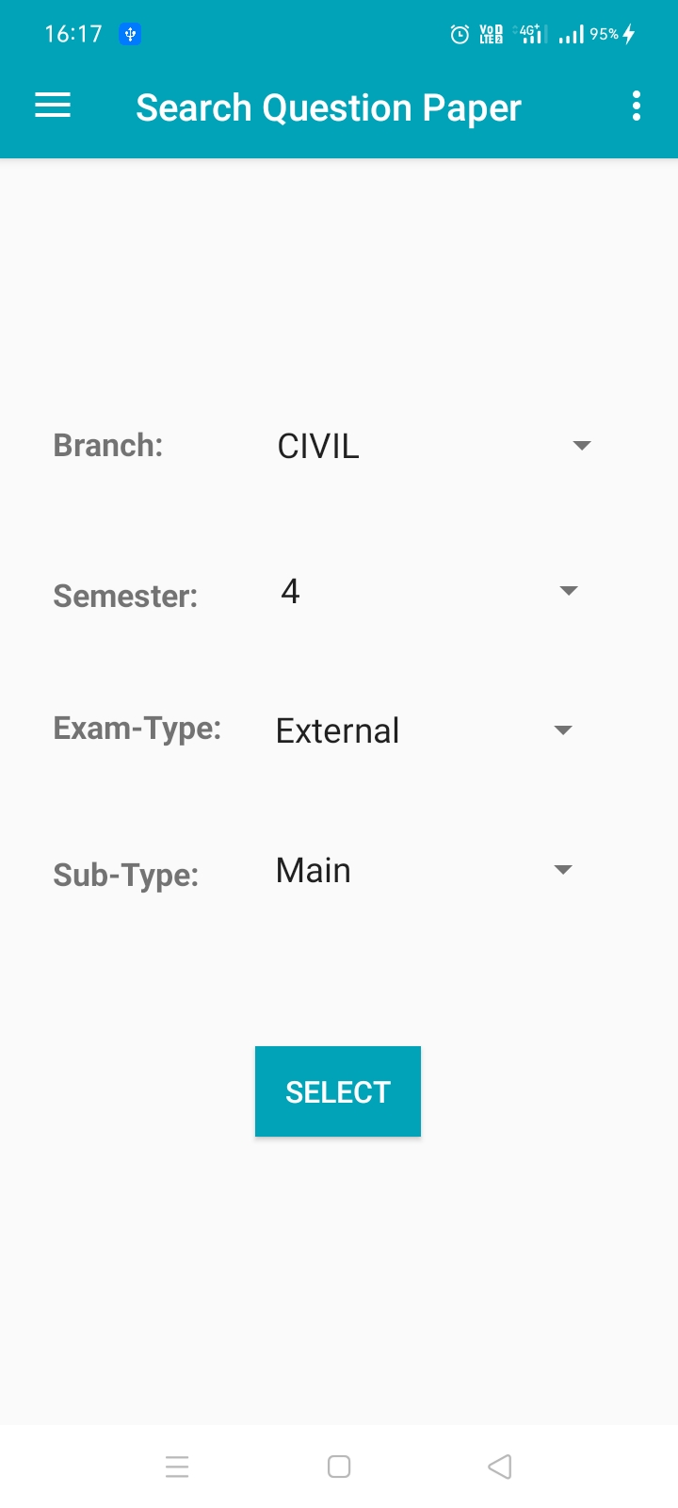
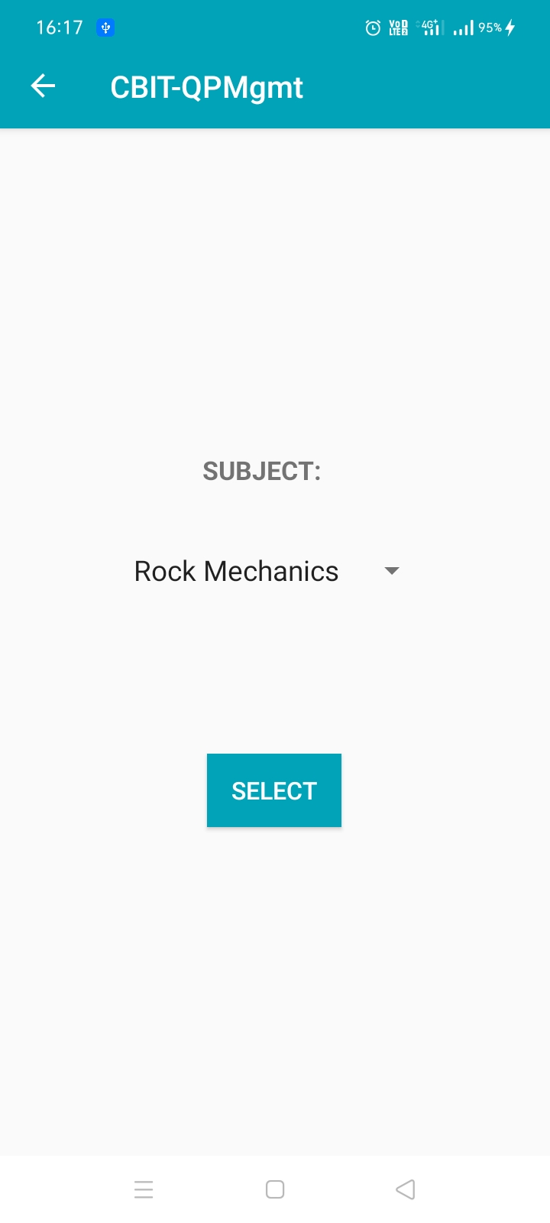
On clicking search question paper menu….

Slide 19
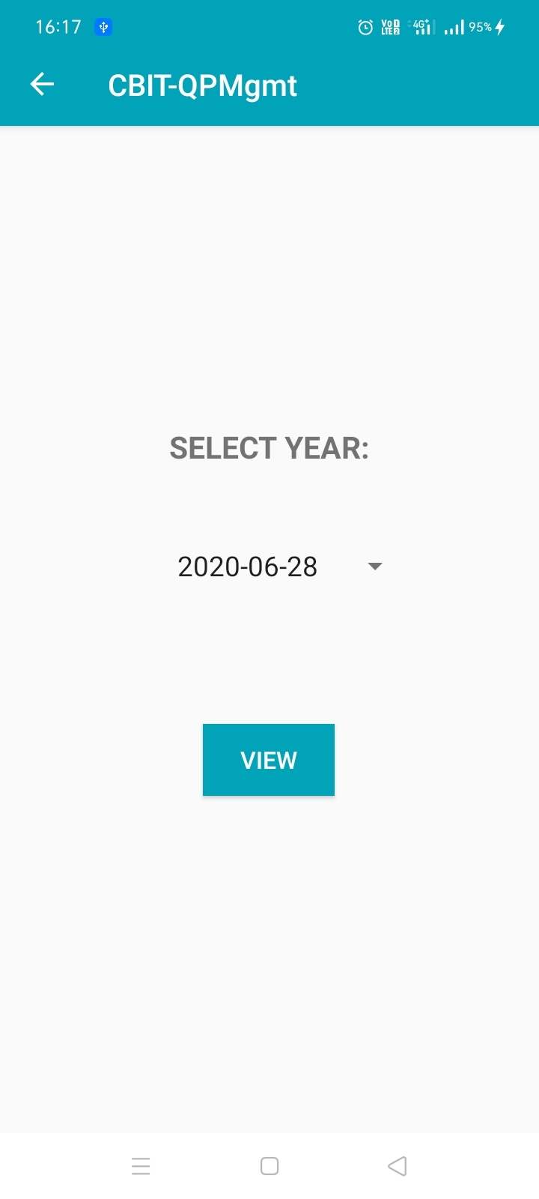
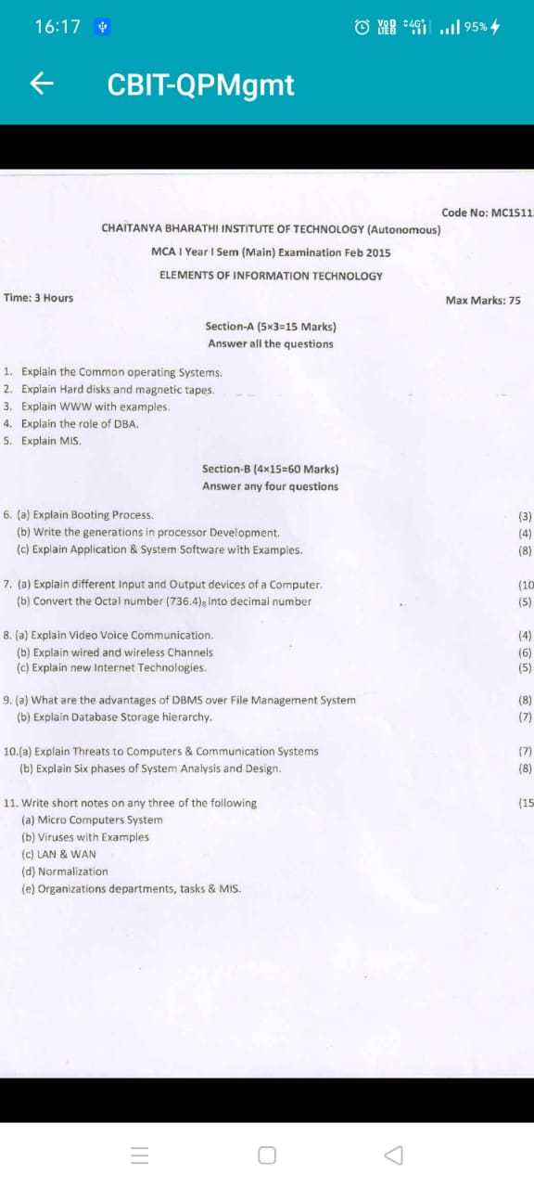
User can view the selected year’s paper

Slide 20
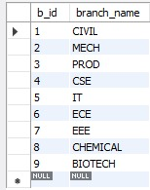
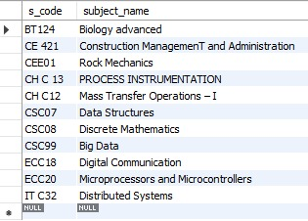
OUR DATABASES
BRANCH TABLE SUBJECT TABLE

Slide 21
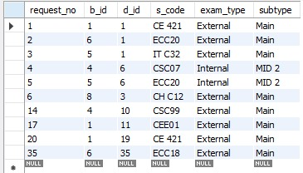
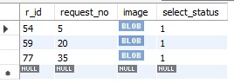
TIME-TABLE TABLE REQUESTS TABLE

Slide 22
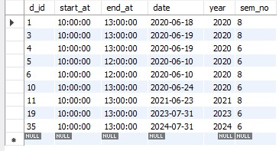
DETAILS TABLE

Slide 23
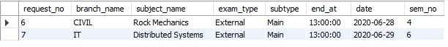
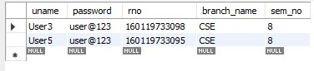
ACTIVE EXAMS TABLE
USERS TABLE

Slide 24
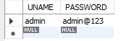
ADMIN TABLE USER SUBMISSION TABLE

Slide 25
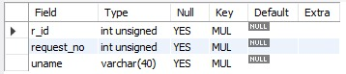
SUBMISSIONS TABLE

Slide 26
API for the Question Paper Management Utility
The API is used in this project for the Admin and the user applications to interact with the database
API developed using Flask RESTful (Python)
Data sent and received in JSON format.
This API uses JWT authentication system to authenticate users and admins.

Slide 27
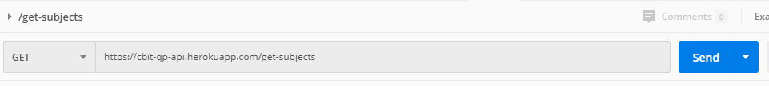
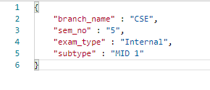
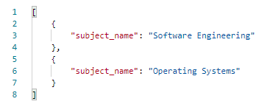
API call – In POSTMAN
ENDPOINT
REQUEST
RESPONSE

Slide 28
A quick walkthrough of the API endpoints
/admin-timetable-create (POST)
/admin-timetable-update (POST)
/admin-timetable-delete (POST)
/admin-get-timetable (GET)
Used for the admin to retrieve, upload, delete or update timetable
Creating timetable adds the exam info to timetable and timings info to details table if not existing already. Also adds entries to active_exams
While updating or deleting, if the details entry is updated, and no other entry of timetable depends on old details entry, then the old one is deleted.
Admin get timetable is used to retrieve the timetable details.

Slide 29
A quick walkthrough of the API endpoints
/admin-qpreq (POST)
/admin-false-select (GET)
/admin-reqno-details (GET)
/admin-delete-req (POST))
Used for the admin to view/approve requests from users, or upload a paper by the admin themself
Admin views un approved requests for a particular exam.
Then the admin approves a paper for a subject and remaining papers get deleted.
Alternatively, admin can upload a paper and the other papers whether approved or not, gets deleted.
When a paper is approved or admin uploads a paper, the corresponding active_exams entry and all user submission details are deleted

Slide 30
A quick walkthrough of the API endpoints
/admin-get-subjects (GET) The admin can obtain all subject names and corresponding subject codes
/admin-login (POST) for admin to login
/user-login (POST) for user to login
/user-register (POST) for user to register

Slide 31
A quick walkthrough of the API endpoints
/qpreq (GET)
/qpreq (POST)
/qp-update (POST)
/qp-delete (POST)
Used for the admin to retrieve, upload, delete or update timetable
The user can upload paper, update paper or delete paper. User data is added to submissions table when uploaded.
The user cannot upload, update or delete paper once the Admin has approved a paper or when admin uploads a paper.
Once paper is uploaded or approved by admin, the submissions entries for the exam are deleted and active exam entries are also deleted.
The qpreq endpoint is used for uploading and retrieving paper

Slide 32
A quick walkthrough of the API endpoints
/get-subjects (GET) – Returns subjects for the fields given by user
/get-yearwise (GET) – Returns year-wise exams details thereby papers
/get-active-exams (GET) – Returns active exams for notification purpose
/get-uploads (GET) – To check if user uploaded or not
/get-uname-info (GET) – Returns the branch, sem and roll number of a user

Slide 33
Key features
Fully secure (JWT Authentication)
Transactions used for multiple query resources are designed in a way inconsistencies are prevented.
Images are sent and retrieved in BASE64 encoded string format.
The API internally converts the BASE64 string to BLOB data while storing and BLOB data is converted back to BASE64 string type while retrieving

Slide 34
END

